Slide 1
Digital Portfolio
STUDENT NAME: Brindha.R
REGISTER NO AND NMID: 2428K0243
DEPARTMENT: Bsc CS(AI&DS)
COLLEGE: COLLEGE/ UNIVERSITY: VET Institutes of arts and Science/Bharathiyar University

Slide 2
PROJECT TITLE :
MY PORTFOLIO

Slide 3


AGENDA
Problem Statement
Project Overview
End Users
Tools and Technologies
Portfolio design and Layout
Features and Functionality
Results and Screenshots
Conclusion
Github Link
3/21/2024 Annual Review

Slide 4

PROBLEM STATEMENT
In today’s competitive landscape, individuals and organizations struggle to identify and invest in talent that blends creativity, strategic thinking, and executional excellence. My portfolio addresses this gap by showcasing a diverse range of projects that solve real-world problems through innovative design, data-driven decision-making, and user-centric solutions. Each piece reflects my ability to translate complex challenges into impactful outcomes, offering a clear narrative of growth, adaptability, and value creation across domains.

Slide 5

PROJECT OVERVIEW
My portfolio is a curated collection of projects that reflect my ability to solve complex problems through innovative thinking, technical proficiency, and a strong sense of design and functionality. Each project demonstrates a unique challenge I’ve tackled—ranging from concept development and execution to final delivery—highlighting my versatility across disciplines. Whether it’s building user-friendly digital experiences, crafting compelling visual narratives, or optimizing systems for performance, my work is driven by a commitment to impact, clarity, and continuous improvement.

Slide 6

WHO ARE THE END USERS?
The end users of my portfolio are professionals, clients, and organizations seeking innovative, results-driven solutions to real-world challenges. Whether it's a hiring manager evaluating my skills, a potential collaborator exploring my creative approach, or a stakeholder assessing the impact of my work, my portfolio is designed to communicate value clearly and effectively. It also serves as a resource for peers and learners who are looking for inspiration, practical insights, or proven strategies across disciplines.

Slide 7

TOOLS AND TECHNIQUES
My portfolio showcases a dynamic range of tools and techniques that reflect both technical proficiency and creative adaptability. I leverage industry-standard software and platforms—such as [insert relevant tools like Adobe Creative Suite, Figma, Python, AutoCAD, etc.]—to bring ideas to life with precision and impact. From wireframing and prototyping to data analysis and visual storytelling, each project demonstrates my ability to choose the right tools for the task and apply techniques that enhance usability, performance, and aesthetic value. This toolkit evolves continuously as I explore emerging technologies and refine my workflow to stay ahead of the curve.

Slide 8
POTFOLIO DESIGN AND LAYOUT
My portfolio showcases a dynamic range of tools and techniques that reflect both technical proficiency and creative adaptability. I leverage industry-standard software and platforms—such as [insert relevant tools like Adobe Creative Suite, Figma, Python, AutoCAD, etc.]—to bring ideas to life with precision and impact. From wireframing and prototyping to data analysis and visual storytelling, each project demonstrates my ability to choose the right tools for the task and apply techniques that enhance usability, performance, and aesthetic value. This toolkit evolves continuously as I explore emerging technologies and refine my workflow to stay ahead of the curve.
8

Slide 9
FEATURES AND FUNCTIONALITY
My portfolio is designed not just to showcase work, but to offer an interactive and intuitive experience that reflects my professional capabilities. Key features include responsive design for seamless viewing across devices, organized project sections with detailed case studies, and embedded media such as videos, prototypes, or code snippets to bring each project to life. Functional elements like search filters, downloadable assets, and contact forms enhance usability, while strategic layout and navigation ensure visitors can easily explore my skills, process, and impact. Every feature is thoughtfully implemented to support storytelling, engagement, and accessibility.

Slide 10
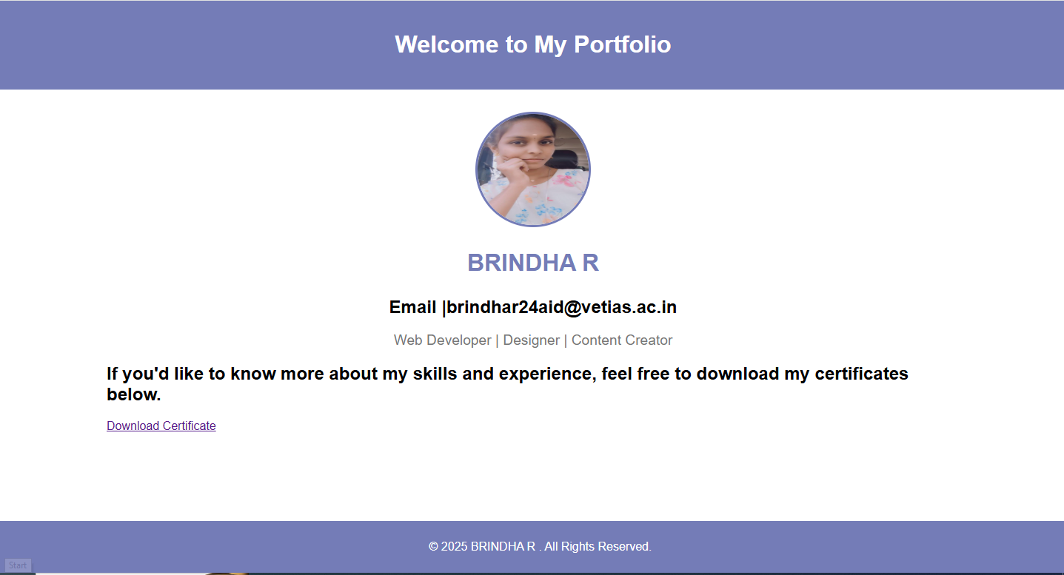

RESULTS AND SCREENSHOTS
3/21/2024 Annual Review
10

Slide 11
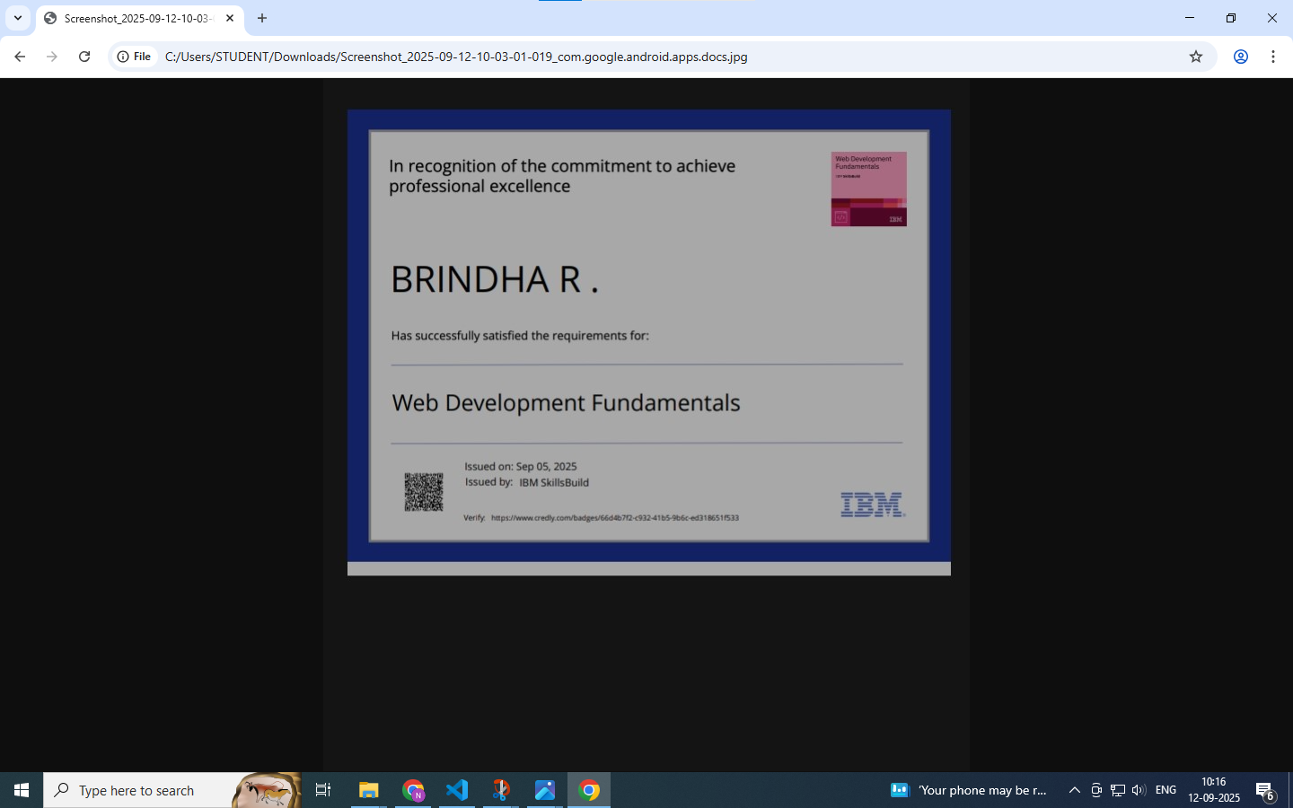

Slide 12
CONCLUSION
My portfolio is more than a showcase—it's a reflection of my journey, my problem-solving mindset, and my commitment to excellence. Each project represents a step forward in my growth, combining creativity, strategy, and technical skill to deliver meaningful results. Through thoughtful design, purposeful functionality, and user-centered thinking, I aim to create work that not only meets expectations but elevates them. As I continue to evolve, this portfolio stands as both a record of what I’ve accomplished and a promise of what I’m capable of building next.
12

